Slide 1
CT4031 Maths for Data Science Week 9 – Hypothesis Testing

Slide 2

What is a hypothesis
?

Slide 3
What is a hypothesis
A hypothesis is an assumption about a population parameter.
Example:
Population: Students on CT4031
Parameter: Assignment Mean

Slide 4
What is a hypothesis
A hypothesis is an assumption about a population parameter.
Example:
Population: Students on CT4031 (120)
Parameter: Assignment Mean (50)

Slide 5
Introducing some terms
Population = all possible values
Sample = a portion of the population
Statistical inference = generalizing from a sample to a population with calculated degree of certainty
Two forms of statistical inference
Hypothesis testing
Estimation
Parameter = a characteristic of population
Statistic = calculated from data in the sample

Slide 6
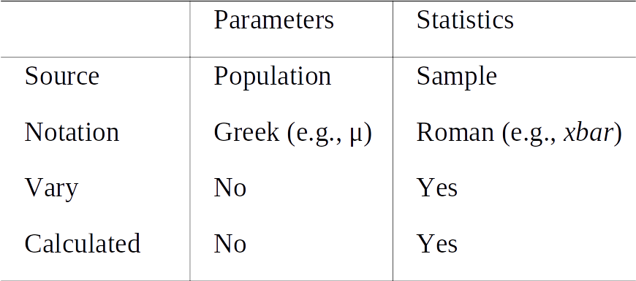
Introducing some terms

Slide 7
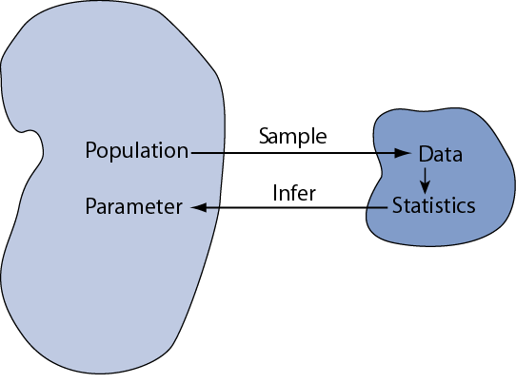
Introducing some terms

Slide 8
The Null Hypothesis, H0
States the Assumption to be tested
Example: The average of iPhones in UK homes is at least 2 (H0: µ ≥ 2)
We begin with the assumption that the null hypothesis is TRUE.
Like the notion of innocent until proven guilty
The Null Hypothesis may or may not be rejected

Slide 9
The Alternative Hypotheses, H1,H2… Hn
States the opposite of the null hypothesis
Example: The average of iPhones in UK homes is less than 2 (H1: µ < 2)
Make sure to cover all grounds (<, >, =, ≠)
The Alternative Hypotheses may or may not be accepted

Slide 10
Steps
State the Null Hypothesis (H0: µ ≥ 2)
State its opposite, the Alternative Hypothesis (H1: µ < 2)
Hypotheses are mutually exclusive & exhaustive

Slide 11
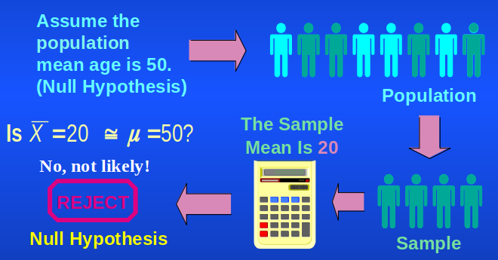
Hypothesis Testing Process
Source: https://bit.ly/3imGoVc

Slide 12
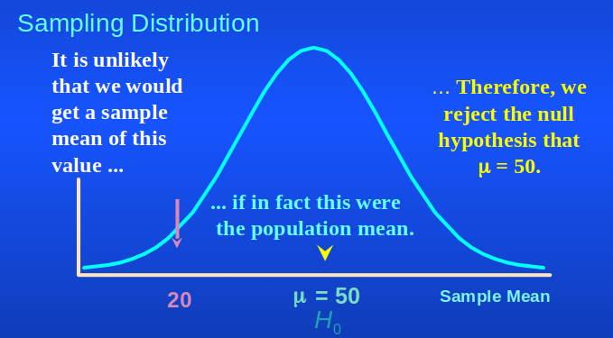
Rejecting hypotheses
Source: https://bit.ly/3imGoVc

Slide 13
Level of significance, aka alpha
α = defines unlikely values of sample statistic if the tested Hypothesis is True
AKA, rejection region of sampling distribution
Typical values are: 0.01, 0.05 and 0.10
It provides the critical value(s) for the statistical test

Slide 14
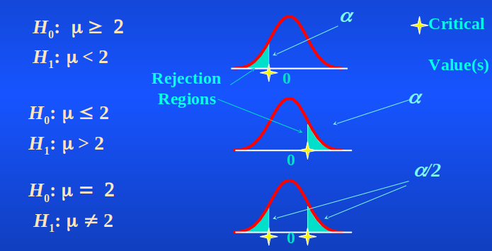
Significance and the Rejection Region
Source: https://bit.ly/3imGoVc

Slide 15
Distributions of a mean
The sampling distributions of a mean (SDM) describes the behaviour of a sampling mean

Slide 16
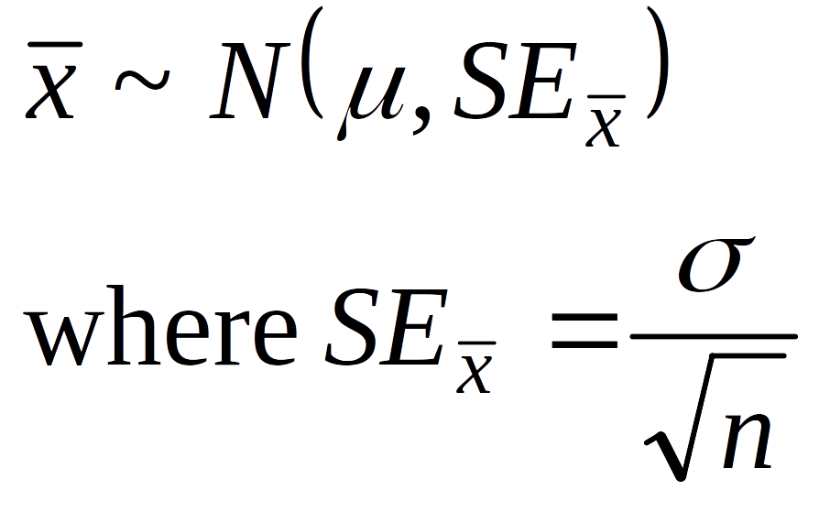
Distributions of a mean
The sampling distributions of a mean (SDM) describes the behaviour of a sampling mean

Slide 17
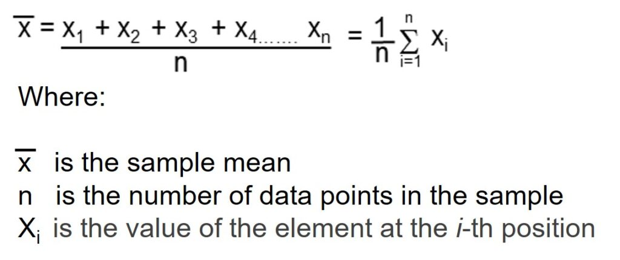
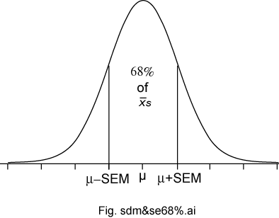
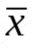
Distributions of a mean
The sampling distributions of a mean (SDM) describes the behaviour of a sampling mean

Slide 18
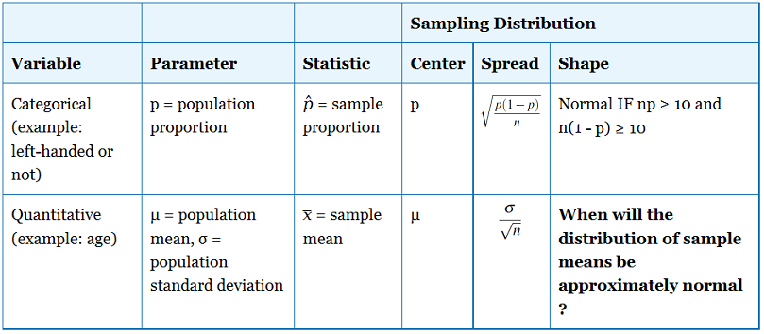
Distributions of a mean

Slide 19
How to perform hypothesis testing?
Tests a claim about a parameter using evidence (data in a sample)
The procedure is broken into 3 main steps:
Null and alternative hypotheses
Test statistic
P-value and interpretation

Slide 20
Let's try an example
The problem: In the 2010s, 20–29-year-old men in the U.K. had a mean μ body weight of 170 pounds. Standard deviation σ was 40 pounds.
Let's test whether the mean body weight in the population now differs.

Slide 21
Let's try an example
1. Null and alternative hypotheses
Null hypothesis H0: μ = 170 (“no difference”)
Alternative hypotheses:
Ha: μ > 170 (one-sided test) or
Hb: μ ≠ 170 (two-sided test)

Slide 22
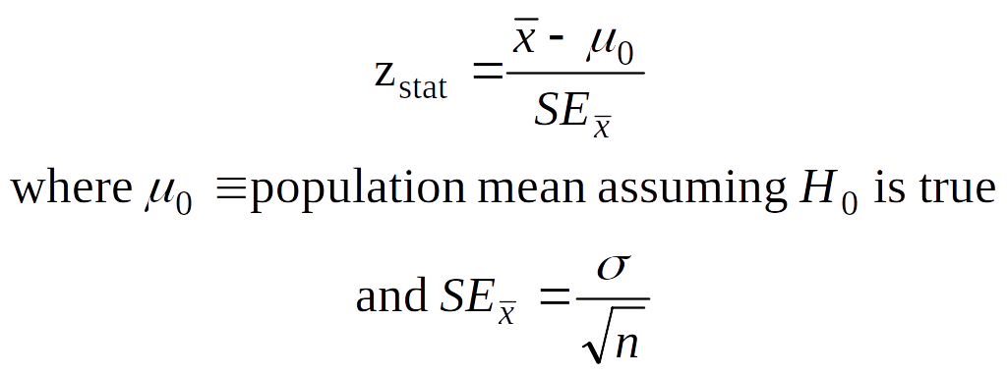
Let's try an example
2. Test statistic
AKA, Z-test

Slide 23
Let's try an example
2. Test statistic
μ=170, σ = 40
Imagine a sample size of n=64

Slide 24
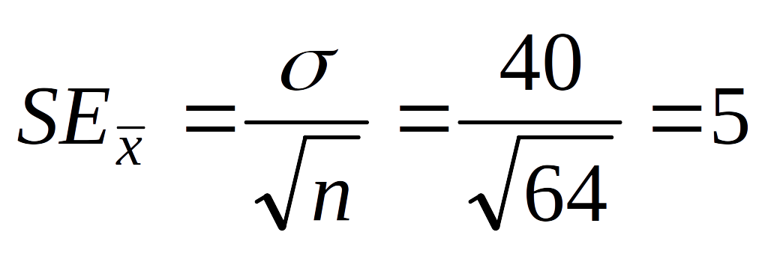
Let's try an example
2. Test statistic
μ=170, σ = 40
Imagine a sample size of n=64

Slide 25
Let's try an example
2. Test statistic
μ=170, σ = 40
Imagine a sample size of n=64
And a sample mean of 173

Slide 26
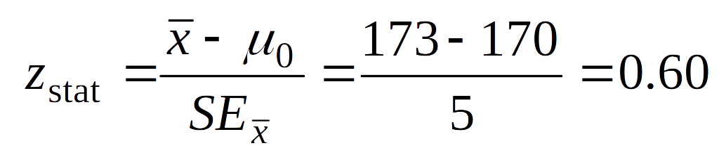
Let's try an example
2. Test statistic
μ=170, σ = 40
Imagine a sample size of n=64
And a sample mean of 173

Slide 27
Let's try an example
2. Test statistic
μ=170, σ = 40
Imagine a sample size of n=64
Now, what if the sample mean was 185?

Slide 28
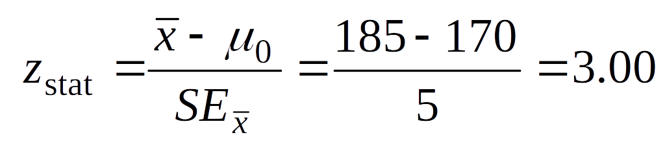
Let's try an example
2. Test statistic
μ=170, σ = 40
Imagine a sample size of n=64
Now, what if the sample mean was 185?

Slide 29
Let's try an example
2. Test statistic
Now what? …. step 3!

Slide 30
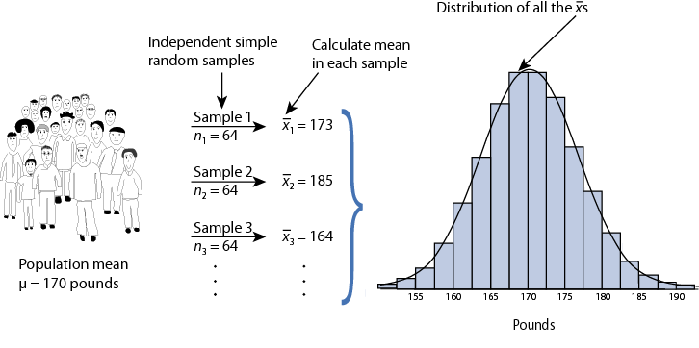
Let's try an example
3. P-value and interpretation
This starts with a sampling distribution

Slide 31
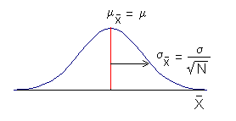
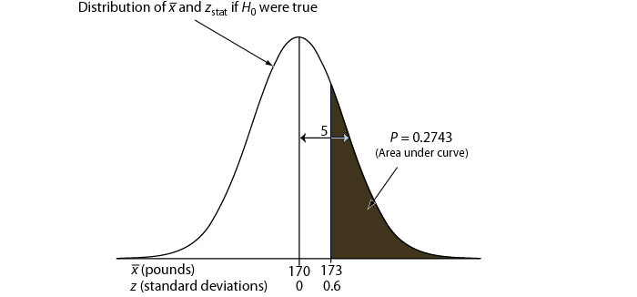
Let's try an example
3. P-value and interpretation
Then... the P-value and interpretation

Slide 32
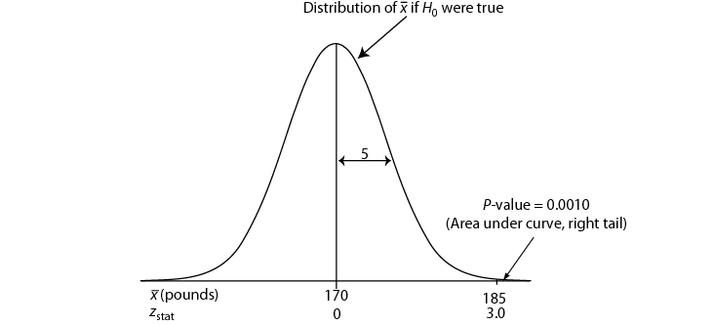
Let's try an example
3. P-value and interpretation
Then... the P-value and interpretation

Slide 33
Let's try an example
3. P-value and interpretation
P-value answer the question: What is the probability of the observed test statistic when H0 is true?
Smaller P-values provide stronger evidence against H0
What about a bigger P-value?

Slide 34
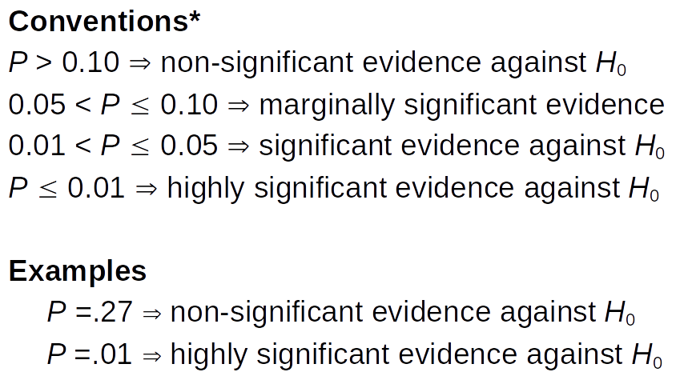
Let's try an example
3. P-value and interpretation

Slide 35
Is that it?
Not really... it is a bit (a lot) more than that.
For starters....

Slide 36
Test Statistic
There are three main tests
Single sample test
Independent samples
Dependent samples
Notes:
https://www.homeschoolmath.net/worksheets/equation_editor.php

Slide 37
Independent and dependent samples
Test differences between two groups/interventions/etc
Mainly used to test if there are differences between them.
H0: µ1 – µ2 = 0
Not statistically different
H1: µ1 – µ2 ≠ 0
Statistically different
Notes:
https://www.homeschoolmath.net/worksheets/equation_editor.php

Slide 38
Independent and dependent samples
Can you think of Examples for using this?
Notes:
https://www.homeschoolmath.net/worksheets/equation_editor.php

Slide 39
Independent and dependent samples
Can you think of Examples for using this?
Vaccines / Drugs
Techniques / Frameworks
Etc...
Notes:
https://www.homeschoolmath.net/worksheets/equation_editor.php

Slide 40
Independent samples
Levene’s Test for Equality of Variances
Equal variances assumed
Equal variances not assumed
Levene's test is used to test if k samples have equal variances. Equal variances across samples is called homogeneity of variance. Some statistical tests, for example the analysis of variance, assume that variances are equal across groups or samples. The Levene test can be used to verify that assumption.

Slide 41
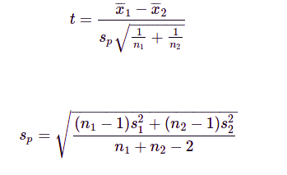
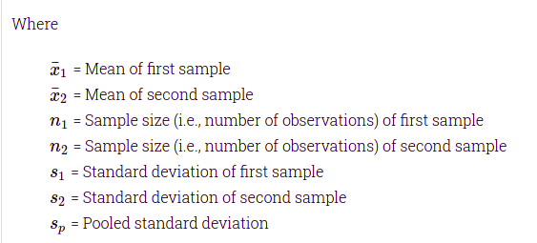
INDEPENDENT SAMPLES
The pooled standard deviation is the average spread of all data points about their group mean (not the overall mean). It is a weighted average of each group's standard deviation. The weighting gives larger groups a proportionally greater effect on the overall estimate.
Equal variances assumed

Slide 42
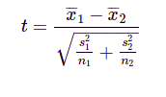
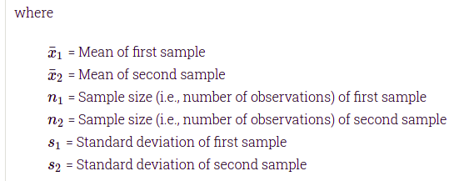
INDEPENDENT SAMPLES
Equal variances not assumed

Slide 43
INDEPENDENT SAMPLES
Let's try two examples

Slide 44
INDEPENDENT SAMPLES
Imagine that there are two different algorithms to sort an array of objects: bubblesort and quicksort.
We won't to know if there is enough statistical difference between using one or the other.
We run an experiment and get the following results.

Slide 45
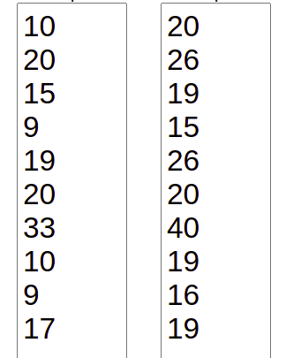
INDEPENDENT SAMPLES
Quicksort Bubblesort

Slide 46
INDEPENDENT SAMPLES
Quicksort Bubblesort
What do you think?

Slide 47
INDEPENDENT SAMPLES
Quicksort Bubblesort
Let's test!

Slide 48
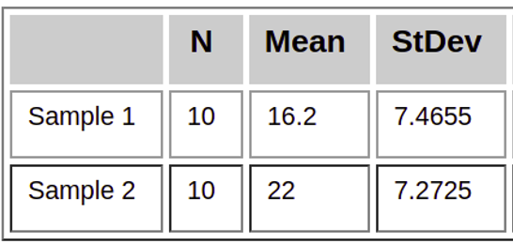
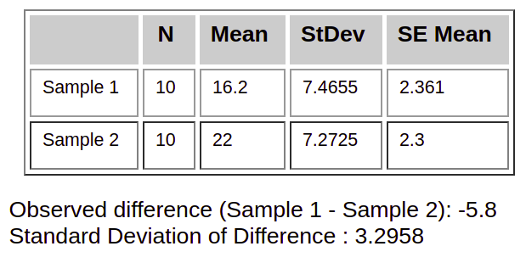
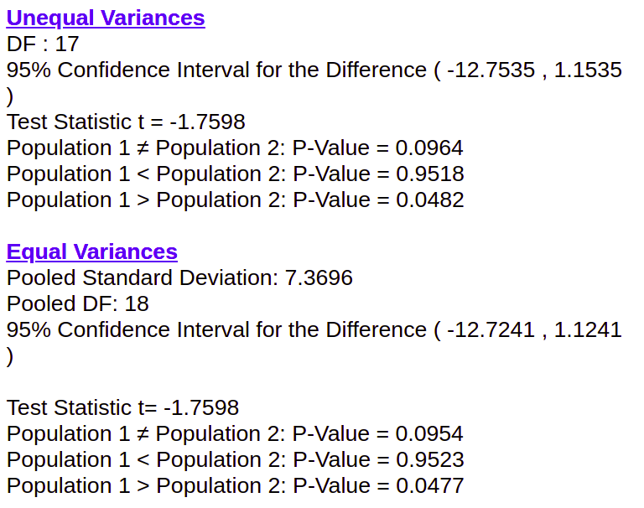
Quicksort Bubblesort
-
-

Slide 49
Useful links
https://www.socscistatistics.com/tests/studentttest/default2.aspx
https://www.omnicalculator.com/statistics/p-value
https://www.socscistatistics.com/tests/ztest_sample_mean/default2.aspx
http://statisticslectures.com/calculators/ttest2/index.php
https://www.omnicalculator.com/statistics/critical-value

Slide 50
INDEPENDENT SAMPLES
Imagine that there are two different algorithms to sort an array of objects: mergesort and quicksort.
We won't to know if there is enough statistical difference between using one or the other.
We run an experiment and get the following results.

Slide 51
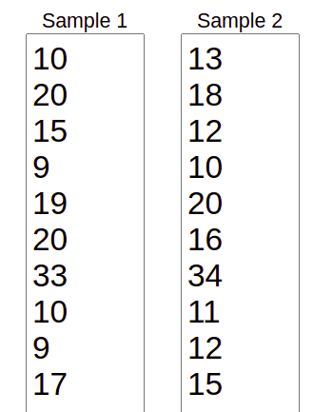
INDEPENDENT SAMPLES
Quicksort Mergesort

Slide 52
INDEPENDENT SAMPLES
Quicksort Mergesort
What do you think?

Slide 53
INDEPENDENT SAMPLES
Quicksort Mergesort
Let's test!

Slide 54
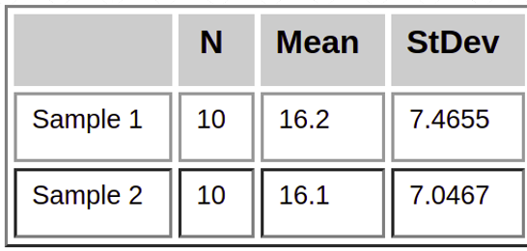
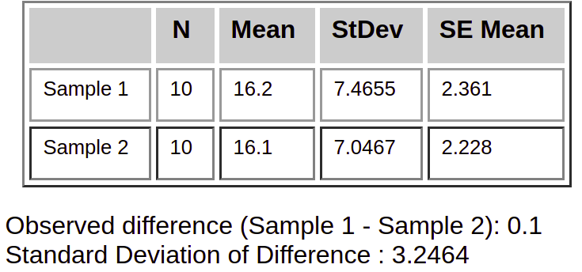
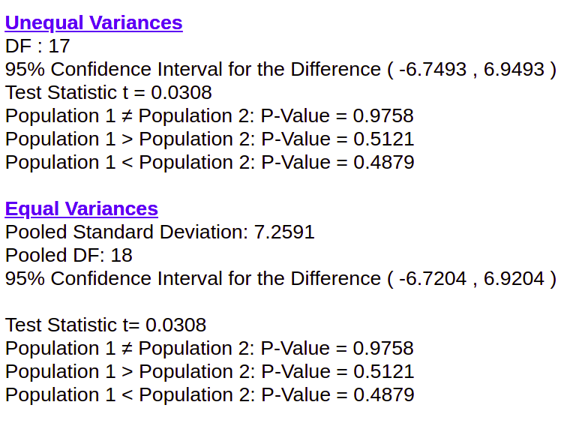
Quicksort Mergesort

Slide 55
Independent and dependent samples
Test differences between two groups/interventions/etc
Mainly used to test if there are differences between them.
H0: µ1 – µ2 = 0
Not statistically different
H1: µ1 – µ2 ≠ 0
Statistically different
Notes:
https://www.homeschoolmath.net/worksheets/equation_editor.php

Slide 56
Independent and dependent samples
You can play some of this here.
Notes:
https://www.homeschoolmath.net/worksheets/equation_editor.php

Slide 57
Post sessional work
What is a mathematical proof? What are the different types of mathematical proof?

Slide 58
References
Sjsu.edu. 2021. [online] Available at: <http://www.sjsu.edu/faculty/gerstman/biostat-text/Gerstman_PP09.ppt> [Accessed 16 July 2021].
Albany.edu. 2021. [online] Available at: <https://www.albany.edu/faculty/shobha/bmsi322/8.ppt> [Accessed 16 July 2021].

Slide 59
Next Session !
Introduction to Mathematical Proof

Slide 60


